Slide 1


Data Protection & Privacy

Slide 2

Checking anonimity of transaction databases through (h,k,p)-Coherence
Flavio Bava
Edoardo Oldrini
Francesco Ciarlo

Slide 3
The Issue
By Paper (Example_1):
AOL has recently made available a query logs database to the public, primarily for research purposes. Nevertheless, through the analysis of search items, the user identified as No. 4417749 was successfully linked to Thelma Arnold, a 62-year-old widow residing in Lilburn. This exemple show that even when queries lack of specific address or name information, it remains possible to re-identify a user, based on distincitve combinations of query terms.

Slide 4
A possible solution
HKP-Coherence
We define a database property where, for a given combination of public items, it ensures that an attacker with a limited and known power (up to “p”) cannot easily link individuals to transactions or private items.
To do so, we require a certain number of transaction containing a combination (β-cohort) and restrinct the presence of common private items in transactions.

Slide 5
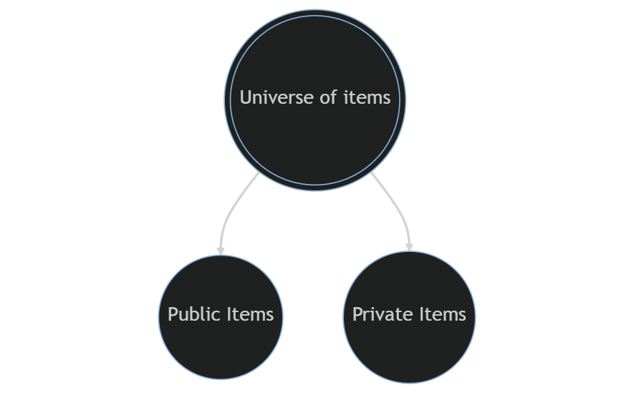
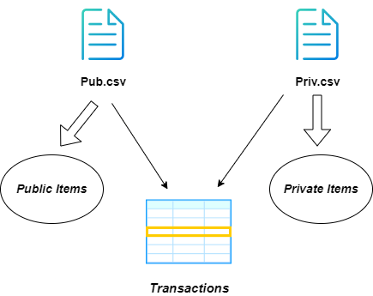
The basic idea

Slide 6
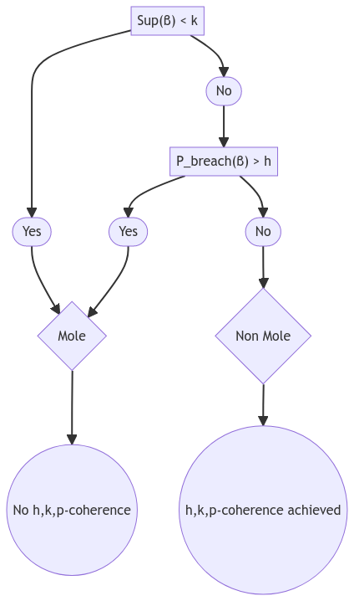
The concept of MOLE
β-cohort refers to the set of transactions that contain β as a subset.
Sup(β), the support of β, denotes the number of transactions in β-cohort.
Sup(β∪{e}) is the probability that a transaction contains e, given that it contains β.
Pbreach(β), called the breach probability of β, is the maximum P(β→e) for any private item e, where P(β→e) = Sup(β∪{e})/Sup(β).

Slide 7
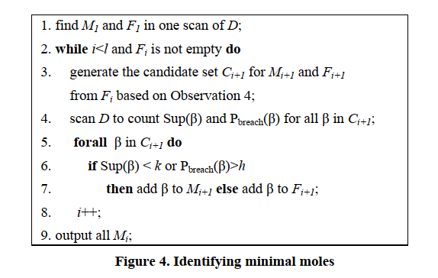
Identifying minimal moles
Our implementation
A loop that iteratively find moles of increasing sizes up to a limit (p) in which we:
Obtain size-1 moles.
Remove size-1 moles from consideration for further iterations.
Explore larger moles' combinations.
Apply conditions to find minimal moles
Update MM dictionary to count elements in minimal moles.
Return:
The dictionary M, holding minimal moles of different sizes.
The dictionary F, with non-moles founded during iterations.
The dictionary MM, tracking element occurrences in minimal moles.

Slide 8
eliminating minimal moles
Four different heuristics:
Let’s define:
MM as the number of times an element appears in a minimal mole
IL as the information lost by eliminating it
Paper approach:
Remove each time the element with the highest MM/IL ratio and repeat this operation until the dataset is anonymized.
Pro: optimal solution
Cons: high computational burden
Half:
Remove each time half of the public elements with the highest MM/IL ratio and continue this process until complete anonymization is achieved.
Pros: High execution speed
Cons: Overshooting information loss
Top X:
Remove each time the top X public elements with the highest MM/IL ratio and continue this operation until the dataset is fully anonymized.
Execution speed and overshooting information loss can be adjusted at will.
Suppress all:
Remove all the public items contained in a minimal mole.
This operation anonymizes the dataset in a single iteration, making the execution speed dependent solely on the number of minimal moles.

Slide 9
Performance analysis summary
Dataset
The dataset used for performance analysis consists of 1000 rows, with 6 columns for public elements and 24 columns for private elements.
Interest
Our objective was to assess the efficiency by varying h, k and p, using four different approaches for minimal moles elimination:
One at a time
Half of them
All of them
Only the first 10-15-20-25
Method
We employed a Python notebook to execute the script with diverse heuristic and of h, k and p values, saving the performance data. Subsequently, we used these results to generate statistics and visual representations

Slide 10
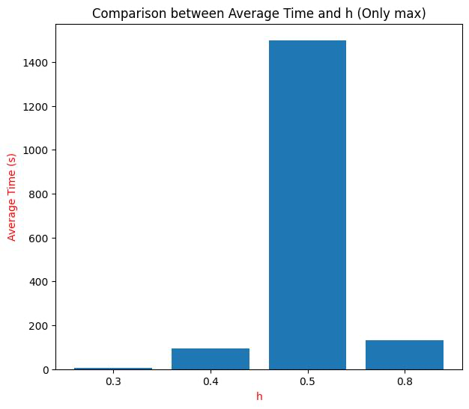
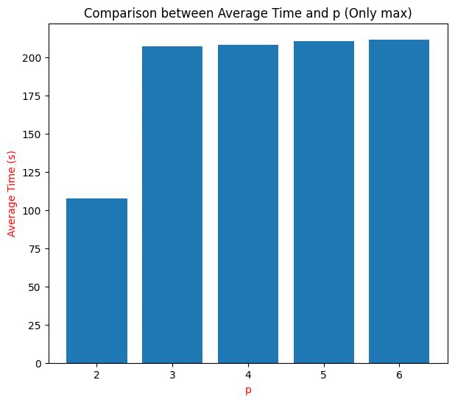
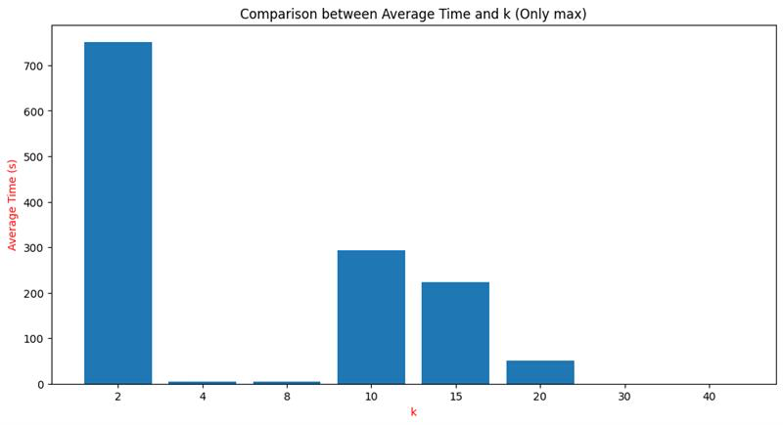
paper approach (Onlymax)

Slide 11
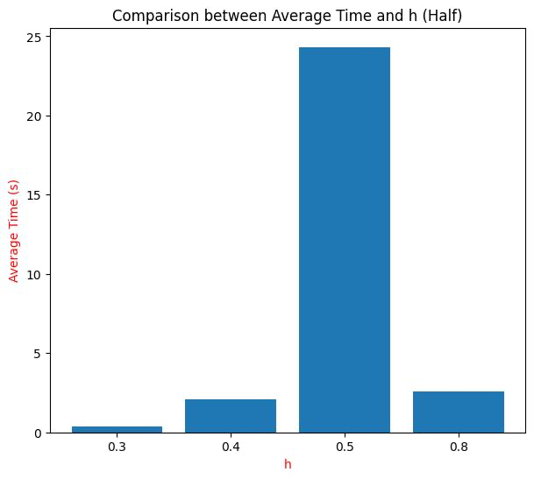
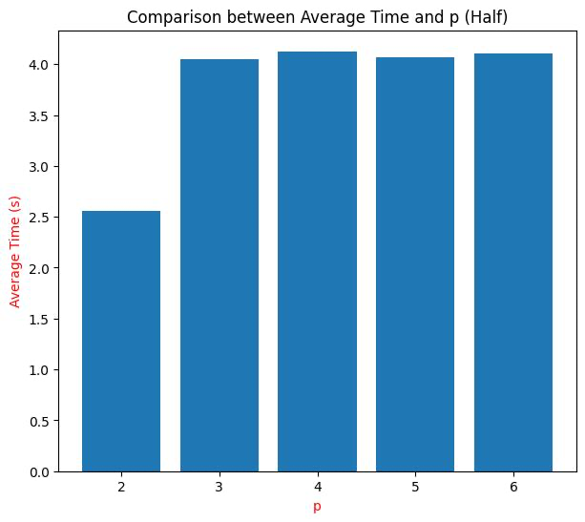
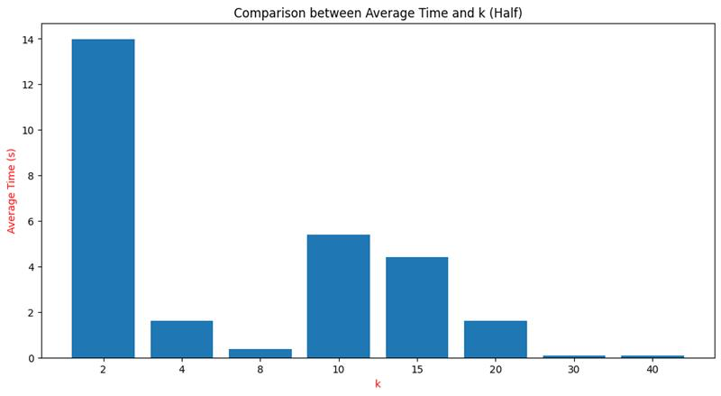
Heuristic i ( half)

Slide 12
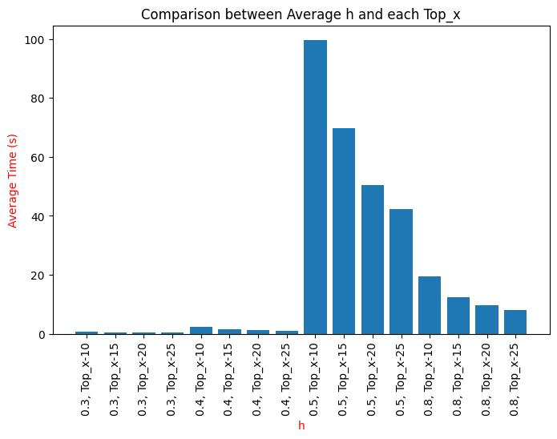
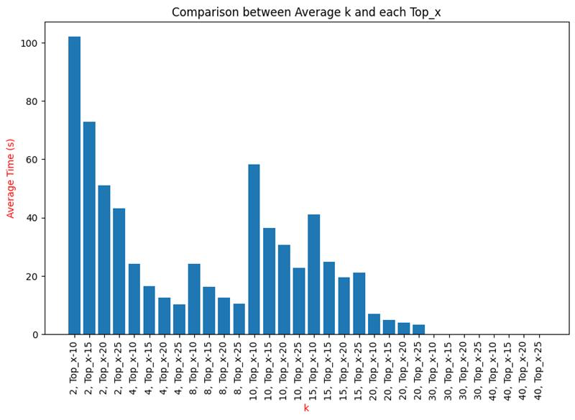
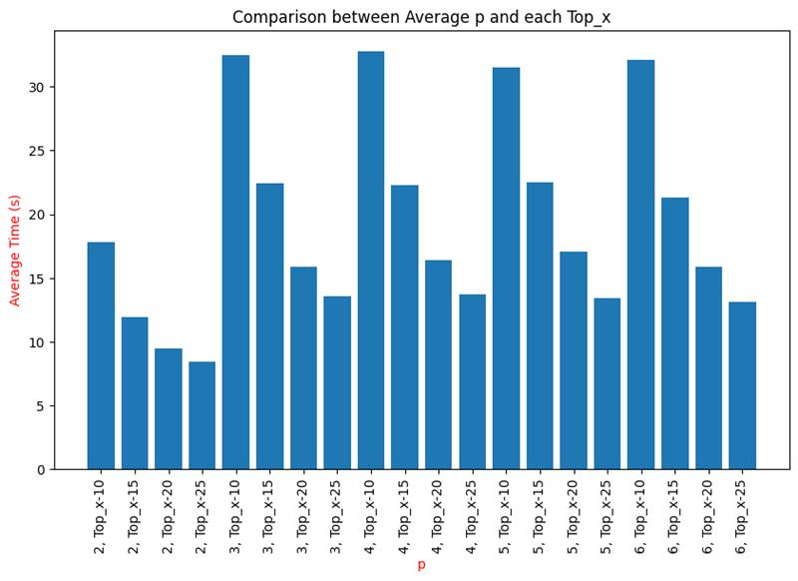
Heuristic ii (TOP X)

Slide 13
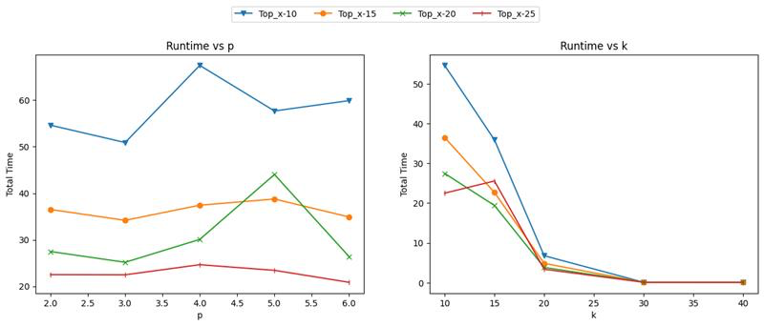
Heuristic ii (TOP X) continue

Slide 14
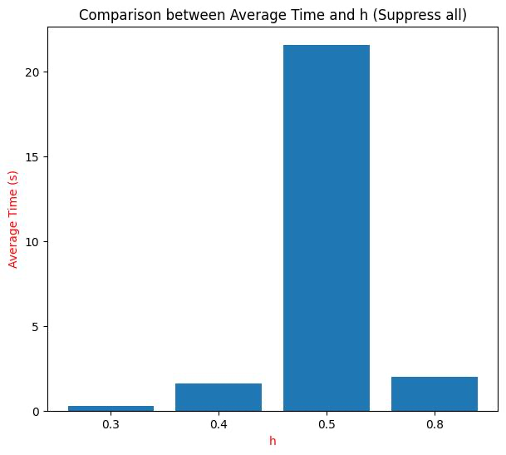
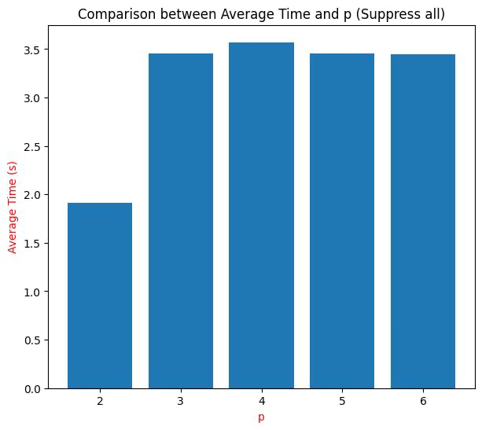
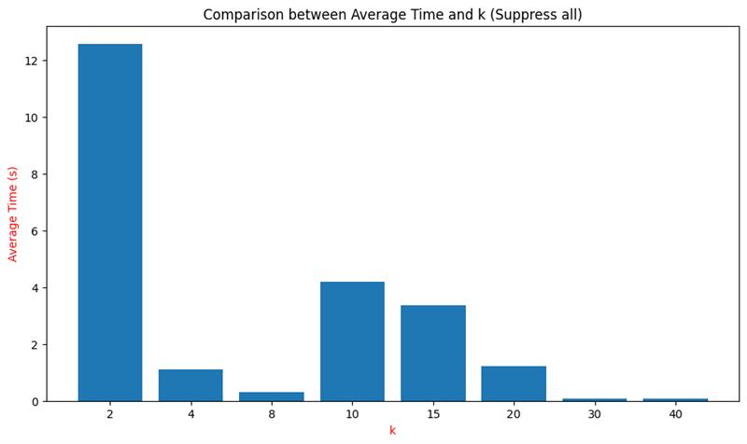
heuristic iii (suppress all)

Slide 15
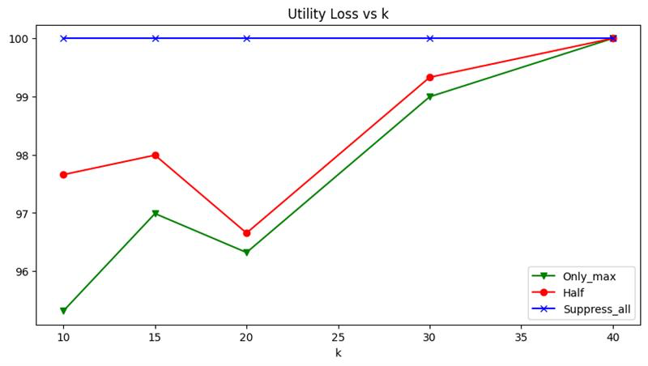
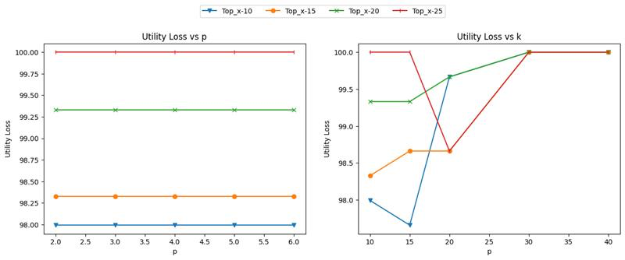
Utility loss
Only_max, Half, Suppress_all
Top X

Slide 16
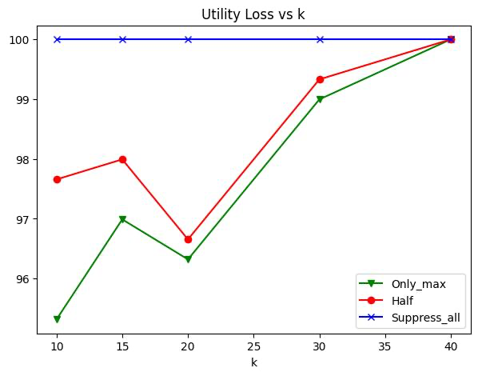
Utility loss
Only_max, Half, Suppress_all
Top X

Slide 17

thanks

